Slide 1
Weekly Update 7.1
Performance Evaluation of Container-Level Anomaly-Based Intrusion Detection Systems for Multi-Tenant Applications Using Machine Learning Algorithms

Slide 2
Main Purpose
Container-level intrusion detection using different ML techniques.
Exploring the use of BoSC technique and Sliding Window algorithm.

Slide 3
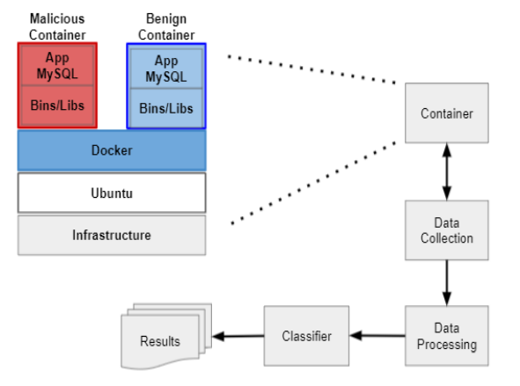
Experimental Environment

Slide 4
Containers
Malicious Container
Database Name: tpcc100_malicious
Image: MySQL version 5.6.27
Attacks:
Authentication Bypass
DoS overflow
Privilege escalation
Integer overflow
Benign Container
Database Name: tpcc100_benign
Image: MySQL

Slide 5
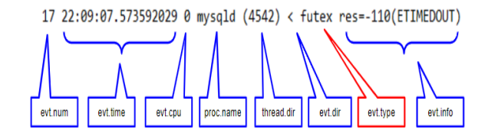
Data Collection & Data Processing
Tool: Sysdig(in write mode)
Output: A csv file of system calls.
System calls related to hardware resources, memory management, input/output processing, network operations, file operations.
Format:

Slide 6
Classifier
Classification of System calls using Label encoder and One hot Encoder.
Classification of System calls using sliding window algorithm.
Classification of System calls using BoSC technique and sliding window algorithm.

Slide 7
BoSC & Sliding Window Algorithm
BoSC is an array < c1, c2, . . . , cns > where ci is the number of occurrences of system call, si , in the current window, and ns is the total number of distinct system calls.
Example:
[0,1,0,2,0,0,0,0,1,0,4,0,0,0,0,0,1,0,0,1] - for ns = 20 and window size = 10.
Notes:
For details: Applying Bag of System Calls for Anomalous Behavior Detection of Applications in Linux Containers

Slide 8
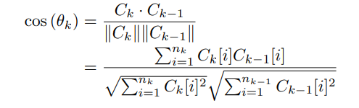
Training Using BoSC
Parameters:
“Other” Threshold(T0)
Epoch Size(S)
Sequence Size
Training Threshold(Tt)
Detection Threshold(Td)
Similarity Metric:

